Slide 1
Customer Situation

Slide 2


Meet the Customer
Contoso Ltd is an established financial services firm, providing many services worldwide, including the insurance offerings below.
Key systems:
Claims management system, customer support, white-labeled portals
Accident and health insurance
Travel, home, and auto coverage
Life insurance

Slide 3


Know the Systems
“To compete with others in the industry, especially with born-in-the-cloud fintech applications, we need to modernize and take advantage of the cloud, but without losing any data or interrupting our services.”
-- Sloane Peterson, Contoso Ltd CIO
Legacy open source web and LOB applications deployed on Linux servers.
SQL Server 2008 R2 on Windows Server 2008 R2 approaching end of life.
No complete, company-wide inventory of servers and applications.
Many undocumented systems not well understood by IT staff.

Slide 4
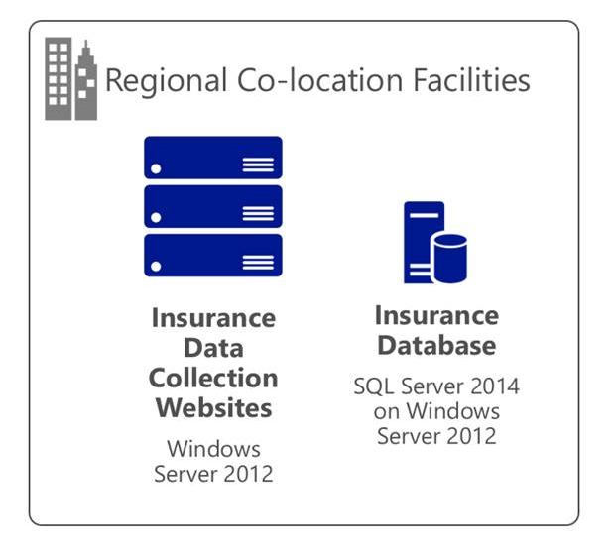
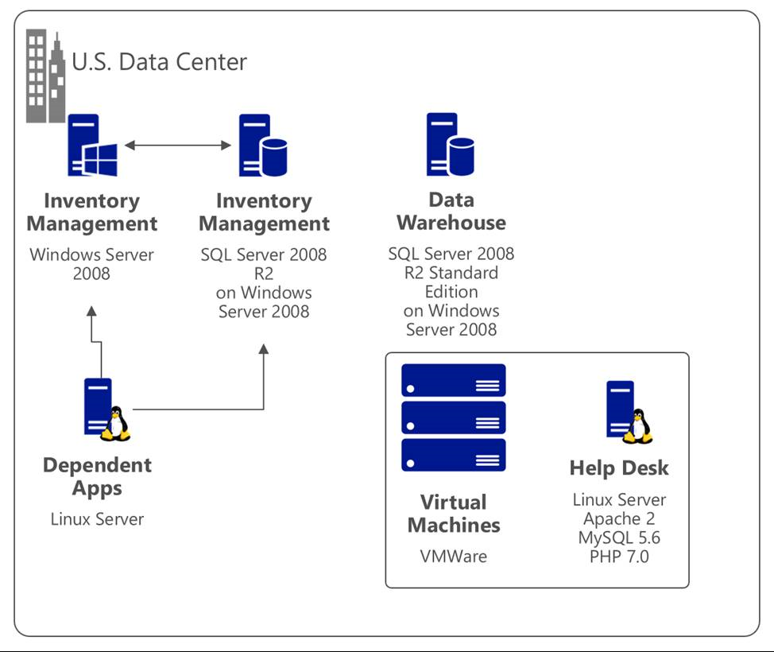
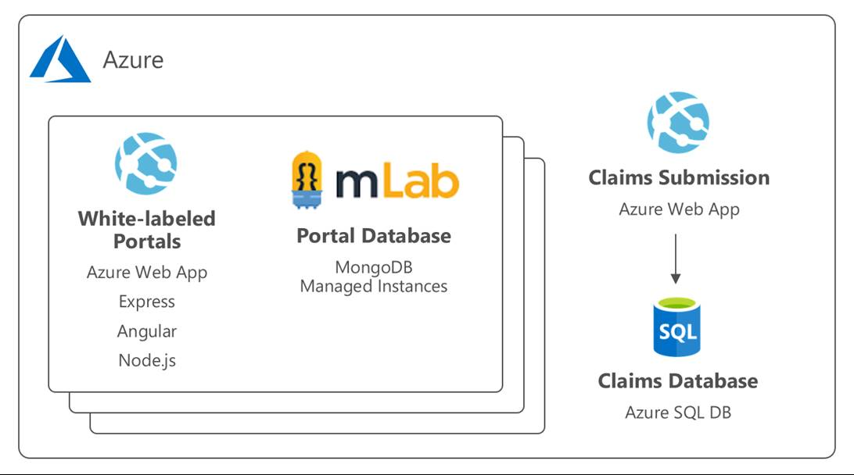
Current Architecture

Slide 5

Data Collection Service
Data Collection Services Mobile agents based all over the world schedule home visits to gather information from insured parties.
Support Staff Support staff process incoming claims and create work orders assigned to mobile agents.
Mobile Agents Mobile agents log in daily to data collection website to retrieve list of insured customers. They then log information back in through TLS (SLL).
“Contoso runs a small data center that is running into performance and capacity issues. This prevents us from keeping up with the growth in our business. Additionally, our database runs on SQL Server 2008 R2, which is approaching end of life.”
-- Kathleen Sloan, CTO

Slide 6

Claims Management
“We would like to rearchitect the system for better scalability so we can take better advantage of new innovations in claims management. We think cloud technologies would be a good fit for this type of application, but don’t have the experience, expertise, or time to rebuild the application right now.”
-- Applications Team
The Claims Management System is one of the most critical systems at Contoso Ltd. Originally architected when the company was much smaller, it runs on:
Windows Server 2008 R2
SQL Server 2008 backend
Highly complex, it is leveraged by various parts of the business with many upstream and downstream dependencies. Some of these dependencies are Linux systems.

Slide 7

Customer Support
“Every few weeks, we have to reboot the VM because the web server stops running. We have noticed error OST98744 in the event log when this happens, but we haven’t had time to look further into it.”
-- IT team member
Helpdesk software is deployed on a single VM running a traditional LAMP stack:
Current versions: Linux Ubuntu 16.04, Apache 2, MySQL 5.6 (100GB DB), PHP 7.0
Hosted on VMWare infrastructure using 8vCPUs and 16GB of RAM
During busy periods the server can get overloaded, so the Contoso Ltd team scaled up the VM, which is why the application requires 8vCPUs.

Slide 8


Operations
“It would be great if the operations team can focus more on being an asset to the company instead of a cost center that is continually maintaining and patching servers that are becoming hopelessly dated.”
-- Operations team member
Customers and partners access the system via the Internet while the Contoso Ltd support teams access the application from the internal network.
Operations is overloaded but not particularly productive, so they would like to offload some of the daily management and maintenance work (especially with their highly available database servers).

Slide 9
White-Labeled Portals
“I believe there will always be a need for custom copies of code. Particular tenants may require a one-off custom implementation. Docker containers may be good for supporting our short-term DevOps and development agility needs. We need to reach a majority multi-tenant application solution.”
-- Arthur Block, VP of Engineering
Financial portal sites are white-labeled when Contoso Ltd delivers services in partnership with other enterprise customers.
They are currently hosted in Azure with the following topology and platform implementation:
MEAN stack (Mongo, Express, Angular, Node.js)
Web sites and APIs hosted in Azure App Services
MongoDB is a managed service provided by mLab on Azure
Engineering goals for improvement:
Reduce regressions introduced in a single tenant when changes are made.
Improve the DevOps lifecycle.
Increase visibility into system operations and health.
Notes:
A claim includes the following information:
Information about the insured (contact information, policy number, etc.)
Free text responses describing the claim (details of what happened, what was affected, the conditions in which it occurred)
Photographs that support the claim (photos of the insured object before the event, photos of the damage or stolen items, etc.)

Slide 10
Data & Data Warehouse
“I know the SQL server has made tremendous gains in features over the last few versions, but I think the upgrade path could be complicated due to the number of dependencies. I’m interested in exploring the public cloud to increase agility, but know that there would be concerns about privacy, security, and compliance.”
-- Kathleen Sloan, CTO
Contoso’s Microsoft SQL Server 2008 R2 Standard Edition data warehouse had a significant outage last year when one of their audit tables ran out of space.
It has also been slowing down as the data has increased.
In the upgrade, Contoso would like:
A full briefing on how to monitor an overloaded Storage Area Network (SAN).
High availability built into the plan.
Decreased software license fees.

Slide 11
Security and Compliance
“I’ve heard great things about Azure’s progress in terms of security and compliance. I’d like to know more about the security features if we move data and applications away from our on-prem data center. If Azure can meet our needs, I’d love to continue our long-standing relationship with Microsoft.”
-- Jack Tradewinds, CISO
Under GDPR laws, Contoso must evaluate their computing environments for compliance gaps.
They will need to:
Maintain HIPAA compliance and SOC2 certification with respect to moving to Azure
Address concerns about regional issues of data sovereignty for sensitive data under GDPR
Ensure the corporate website and external-facing website are sufficiently isolated and secure

Slide 12
Machine Learning & AI
“We’ve identified claims processing as the first area to focus on as we build a next-generation platform. Using AI to search through claim details and artifacts could significantly reduce costs and save time for our agents.”
-- Sloane Peterson, CIO
Contoso is excited to learn how injecting cognitive services, machine learning and deep learning into their new platform can transform claims processing.
Claims include:
Information about the insured (contact information, policy number, etc.)
Free text responses describing the claim (details of what happened, what was affected, the conditions in which it occurred)
Photographs that support the claim (photos of the insured object before the event, photos of the damage or stolen items, etc.)
All details are stored as opaque attachments, which are not searchable.

